Slide 1
Revision lecture

Slide 2
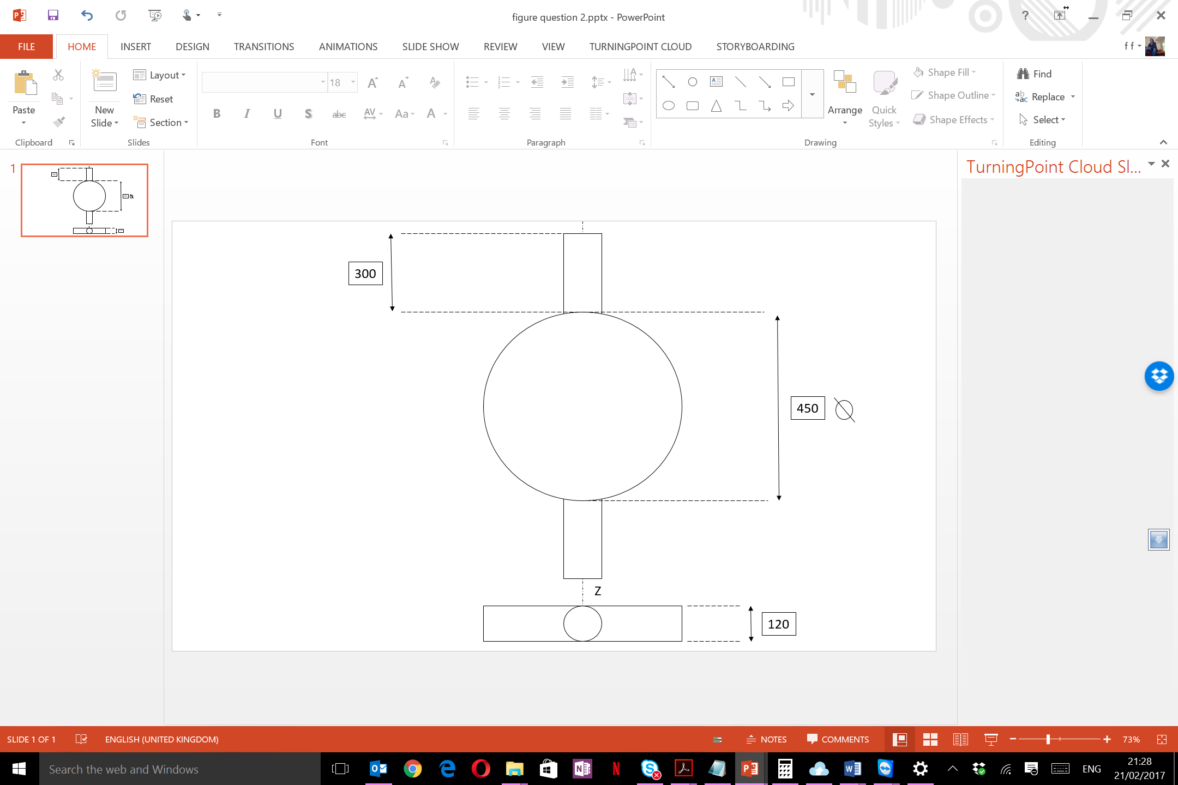
Question B2
To test the component shown in Figure 3, it is spun at 5000 Rev.min⁻¹ around the Z-Z axis using a directly coupled permanent magnet brushed d.c. motor. Assuming that the component has a uniform density of 4000 kg.m⁻³, determine:
  The inertia of the component, around the axis of rotation, and hence the torque required to accelerate the component to 5000 rev min⁻¹ in 20 seconds.
  The stored energy in the rotating system at 5000 rev min⁻¹
  Based on the results from part (a), estimate the constant braking torque required to stop the motor from 5000 rev.min⁻¹ to 0 rev.min⁻¹ in 20s. Then, determine the associated regenerative current and the energy returned to the supply, assuming a constant regenerative current throughout.
The motor’s constants are K_{e}=0.6 Volt sec Rad⁻¹ and K_{t}=0.6 Nm Amp⁻¹. The motor’s rotor resistance is 0.2 Ohm and its inertia is 0.15 kg.m²
(In millimetres)

